Slide 1

Predicting Football Player Goal Scoring Using AI
Sotia Koukou & Victoras Panayiotides
Professors: Pavlos Protopapas, Ignacio Becker
Mentors: Anshika Gupta, Nawang Thinley Bhutia

Slide 2
Problem Statement
Predicting the number of goals a player, from the premier league, will score in an upcoming match..
Importance of this prediction:
Useful insight for the scouting department of the team.
Setting up the starting XI and adjust the tactics of the match.
Helps manage the team's attacking players and help the scouting team make decisions on potential transfers.
Assists fans to bet on players scoring in upcoming matches.
Notes:
1. Predicting the number of goals a player is going to score in an upcoming match is a
2. Knowing the goals that will be scored in an upcoming match by a player will help

Slide 3
Our approach:
We imported the necessary libraries needed for the program, and used panda’s attribute ‘pd.read_csv’ to upload the datasets.
We removed missing values and removed columns with many missing data using pandas attributes ‘isnull()’ and ‘.drop()’.
We visualized our data using heatmaps, scatterplots and histograms
Notes:
Pics

Slide 4
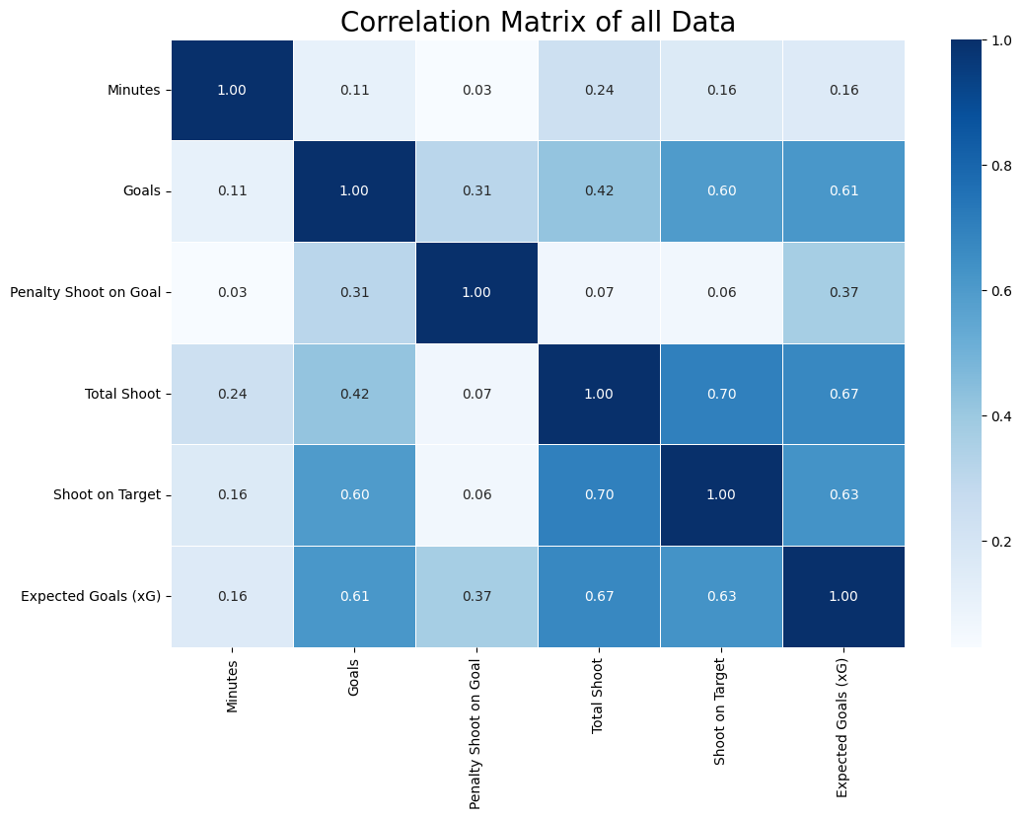
Visualizing data
We started by plotting a correlation heatmap to investigate the correlation between all of our predictors.
.
.
.
Notes:
Pics

Slide 5
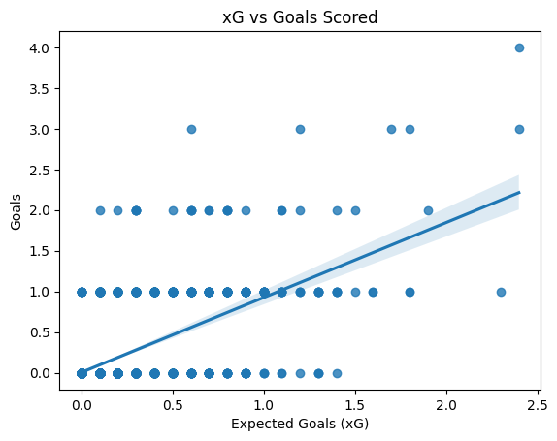
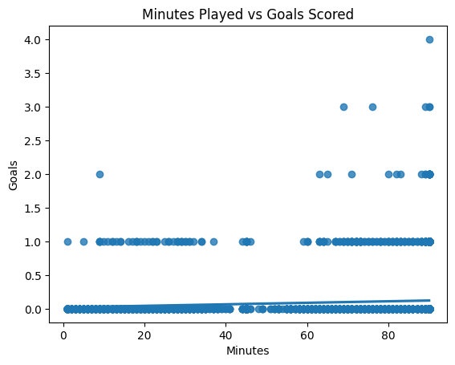
Plotting data
Then we plotted Scatterplots with regression lines to examine the relationships of the predictors with the response variable.
.
.
.
Notes:
Pics

Slide 6
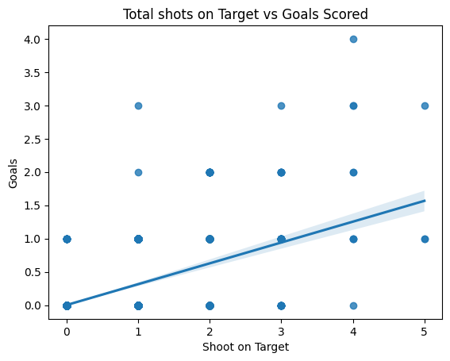
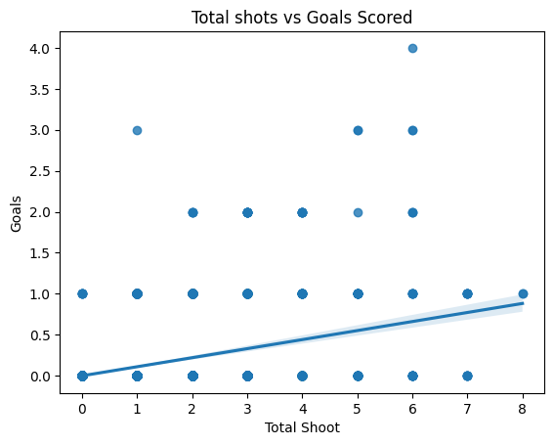
Plotting data
Then we plotted Scatterplots with regression lines to examine the relationships of the predictors with the response variable.
.
.
.
Notes:
Pics

Slide 7
Our approach:
We grouped the data to find the mean number of goals of each player and then proceeded to calculate the RMSE for each one.
We then applied a Linear Regression model for each player, to predict the number of goals and again found the RMSE.
Notes:
Pics

Slide 8
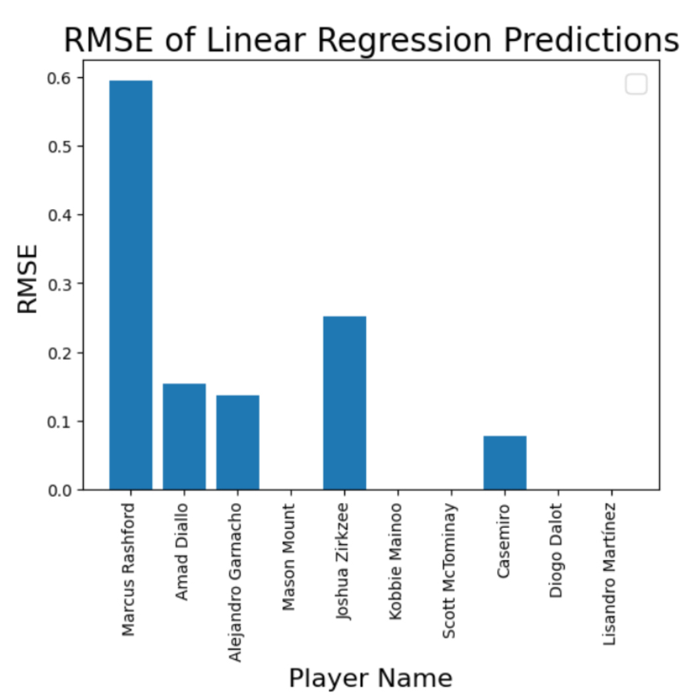
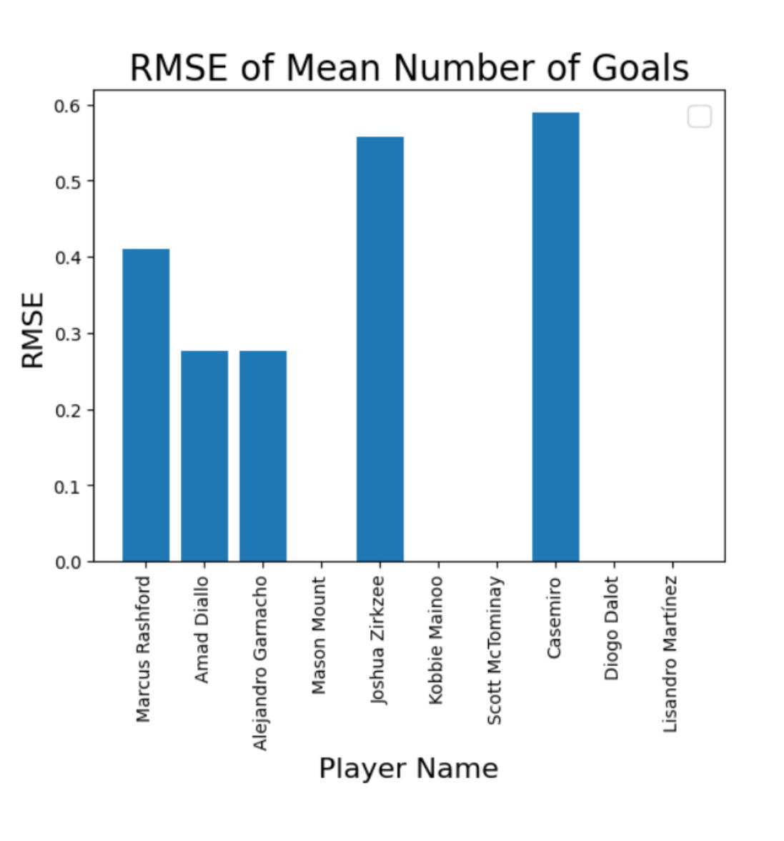
Our approach:
Notes:
Pics

Slide 9
Our approach:
We grouped the data to find the mean number of goals of each player and then proceeded to calculate the RMSE for each one.
We then applied a Linear Regression model to predict the number of goals and again found the RMSE for each player.
Lastly, using an input statement form the user we used Decision Trees to predict the number a goals that player will score in an upcoming match.
Notes:
Pics

Slide 10
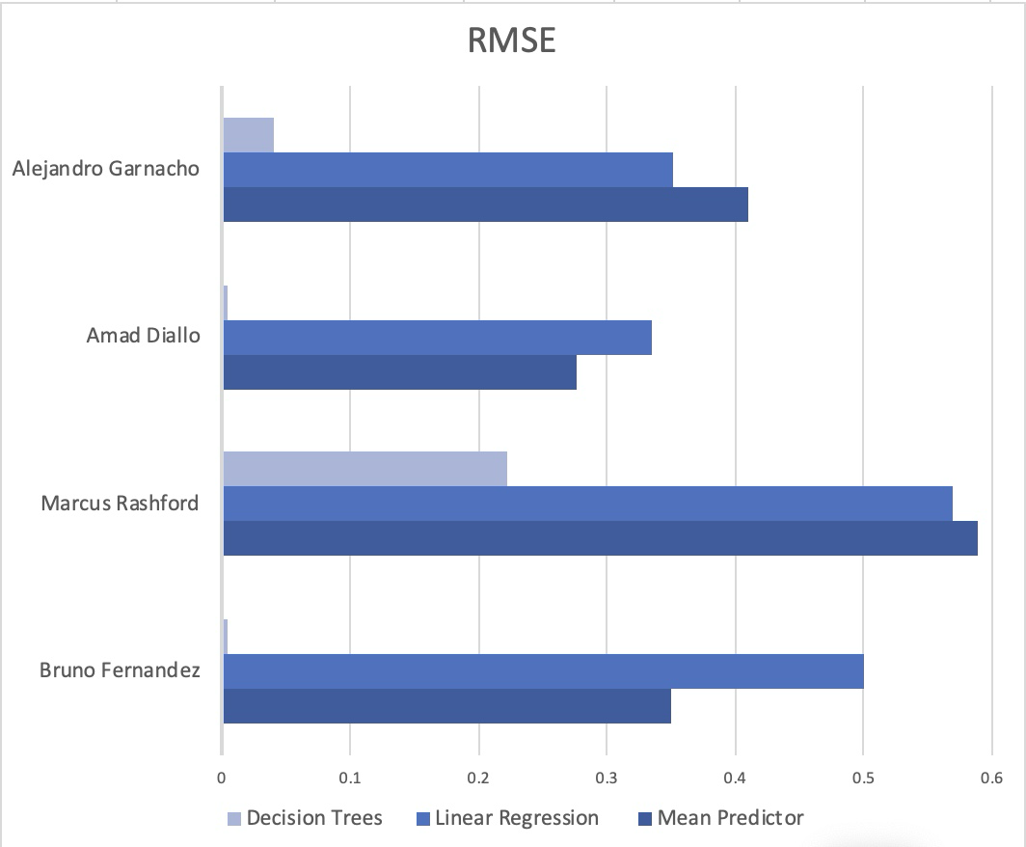
How we solved the problem of high errors:
Using Decision Trees we made sure to minimize the error of our previous models.

Slide 11
Future Modifications
In the future, in order to better improve the accuracy of our model we will add data of opposing teams and take into account how they affect the number of goals scored depending on their level of defense and goalkeeping skills.
Moreover we will take into account injury history and how it affects the performance of players in the field.
We will try if possible to predict the number of goals the player is going to score in an upcoming match depending on his statistics of that match that will be inputted by the user.

Slide 12
Conclusion:
We used machine learning techniques such as: Linear Regression, Mean Predictor and Decision Trees, to create the most accurate model we can.
We used the RMSE matrix to evaluate our models.
The most accurate model was Decision Trees which appeared to have the lowest RMSE scores.
We achieved our goal by accomplishing to predict the number of goals a player is likely to score in an upcoming match, having low error.

Slide 13
Thank you
for
your Attention!

